Slide 1

COMMUNICATION

Slide 2
Human Communication
Verbal
Intrapersonal Interpersonal Mass Media Business Communication
Formal Informal
Vertical Horizontal Consensus
Grapevine
Downward Upward
Non Verbal
Kinesics
Occulesis
Paralanguage
Proxemics
Artifacts
Chronemics
Tactilics

Slide 3
DOWNWARD COMMUNICATION
Downward communication flows from a superior to a subordinate. Orders, individual instructions, policy statements, job-sheets, circulars, etc., fall under downward communication.
Main Objectives of Downward Communication
To give specific directives about the job being entrusted to a subordinate;
To explain policies and organisational procedures;
To apprise the subordinates of their performance; and
To give the subordinates information about the rationale of their job so that they understand the significance of their job in relation with the organizational goals.

Slide 4
DOWNWARD COMMUNICATION
Media for Downward Communication
Downward communication may be both oral and written.
Important directives to initiate actions may be communicated through letters;
Policies and procedures may be announced through circulars, house organs, manuals, bulletins, etc.;
Annual reports may be found suitable for acquainting the lower staff with the activities and achievements of the organization during the year;
Posters may be used to pass on miscellaneous information.

Slide 5
DOWNWARD COMMUNICATION
Limitations of Downward Communication
Under-communication and over-communication: Downward communication is often marred by either under-communication or over-communication. Under-communication may involve incomplete instructions, which will inevitably lead to unsatisfactory performance. Over-communication or talking too much, on the other hand, may lead to the leakage of confidential information, or the message may get lost in a jungle of irrelevant details.

Slide 6
DOWNWARD COMMUNICATION
Delay: The lines of communication in downward communication being very long, transmitting information to the lowest worker is a time-consuming process. By the time information reaches them, it may have lost much of its significance, or it may have caused damaging delay.
Loss of Information: Unless the communication is fully written, it is not likely to be transmitted downwards in its entirety. A part of it is almost certain to be lost.

Slide 7
DOWNWARD COMMUNICATION
Distortion: In long lines of communication, information is not only lost but even distorted. Exaggerating, making under-statements, giving unconscious twists to facts are a part of human nature. Whenever a piece of information passes on from one individual to another, it loses a little of its authenticity. By the time it reaches its destination, it may not contain even an iota of truth.
Built-in resistance: Downward communication smacks of too much authoritarianism. The subordinates do not get any opportunity of participating in the decision-making process. They are expected to receive the policy decisions and directives without questioning their appropriateness, utility or validity, which they dislike.

Slide 8
DOWNWARD COMMUNICATION
Essentials of Downward Communication
Managers should keep themselves well informed of the objectives, activities and achievements of their organization. If they are themselves in possession of adequate information, they will be able to transmit information to their subordinates in an effective manner.
Managers must work according to a communication plan. They must decide beforehand how much information is to be communicated and at what time. This will ensure that there is neither a communication gap, nor over-communication or under-communication.

Slide 9
DOWNWARD COMMUNICATION
Essentials of Downward Communication
There should not be over-concentration of authority at the highest level. If an organization is so structured that orders and instructions can originated at various levels, the lines of communication will be shortened. Downward flow will gain momentum. Delays will be eliminated. Loss of information and the possibility of distortion will be minimized, if not fully checked.
Information must be passed on to the correct person in the hierarchy.

Slide 10
UPWARD COMMUNICATION
The communication channel which pushes the flow of information upward is known as the upward channel of communication.
Importance of Upward Communication
Providing feedback: Upward communication provides the management with necessary feedback. The management is able to ascertain whether the directives issued to the lower staff have been properly understood and followed. It also gets valuable information on what the employees think of the organization and its policies.

Slide 11
UPWARD COMMUNICATION
Outlet for pent-up emotions: Upward communication gives the employees an opportunity to vent their problems and grievances. Although the management often thinks it knows and realizes the grievances of the employees, the latter hardly feel convinced and satisfied. In any case, it is of vital importance to look at the employees’ problems as they look at them. The genuine and pressing grievances are redressed; a ground is prepared for the solution of some other problems; and with regard to those problems which cannot be immediately solved, at least the employees feel light after having talked about them.

Slide 12
UPWARD COMMUNICATION
Constructive suggestions: Often employees offer constructive suggestions to promote the welfare of the organization. Some of these suggestions, when implemented, definitely prove beneficial.
Easier introduction of new schemes: Since the employees feel themselves to be a party to the decision-making process, it helps the organization to introduce new schemes without unduly antagonizing the employees. They not only willingly lend their concurrence and support to any new scheme floated by the management but even take extra pains to make a success of it.
Greater harmony and cohesion: Upward communication acts as kind of lubricant. It makes the atmosphere in the company congenial and creates great harmony and cohesion between the management and the employees.

Slide 13
UPWARD COMMUNICATION
Methods of Upward Communication
Open-door policy: The employees are given a feeling that the manager’s doors are always open to them. Whenever they like they can walk into his room, without any hesitation whatsoever, and talk to him about their problems.
Complaints-and-suggestions boxes: At some convenient places in the office or the factory, complaints-and-suggestions boxes are installed. The employees are encouraged to drop their complaints or suggestions, if any, into these boxes.

Slide 14
UPWARD COMMUNICATION
Methods of Upward Communication
Social gatherings: Social gatherings are frequently arranged in different departments. These gatherings offer a very informal atmosphere in which the employees shed their inhibitions and feel free to talk about their problems.
Direct correspondence: Sometimes the manager may directly write to an employee and ask him/her to communicate with them. Or the employees may write to their higher-ups at their own initiative.
Reports: Employees may be required to submit reports about the progress of their work at regular intervals.

Slide 15
UPWARD COMMUNICATION
Methods of Upward Communication
Counselling: In some organizations, workers are encouraged to seek the counsel of their supervisors on their personal problems. What they think to be their personal problems are often a conglomeration of domestic and official problems. In the office, they often feel stifled because of lack of promotional avenues or offended by the officious or unduly meddlesome nature of their superiors or even their colleagues. As they feel encouraged to talk about themselves freely, they provide the managers with valuable information. While counselling helps the employees to solve their problems, the information provided by them is utilized by the managers to give a better shape to their future policies.

Slide 16
UPWARD COMMUNICATION
Limitations of Upward Communication
Employees are usually reluctant to initiate upward communication. The managers might keep their doors open, but they cannot force the employees to walk into their room.
Employees often feel that if they communicate their problems to their superiors, it may adversely reflect on their own efficiency.

Slide 17
UPWARD COMMUNICATION
Upward flow of communication is more prone to distortion than downward communication. In downward communication, distortion is often unconscious. But upward communication is deliberately distorted. Some managers lose their cool if they are confronted with unpleasant or unpleasant facts. So information, particularly of unpleasant sort, is suitably ‘edited’ before it is passed on to them.
Sometimes in the process of upward communication, workers become too bold, ignore their immediate superiors and directly approach the top-most authorities with their suggestions or complaints. This proves harmful in two ways. The officers who have been by-passed feel slighted, while the high-ups get suspicious of the workers’ intentions. The relations between the workers and their immediate superiors get strained and work suffers.

Slide 18
UPWARD COMMUNICATION
Essentials of Upward Communication
In order to enable the workers to overcome the awe of authority, the managers should keep on encouraging them to come out of their shell and communicate freely. It is futile to expect the workers to take initiative. Any initiative to be taken, must be taken by the managers.
Distortion by ‘editing’ can be avoided if the lines of communication are kept short.
All upward communication should be properly analyzed. Genuine grievances deserve to be immediately resolved. Suggestions for improvement, if found feasible, should be taken up for implementation and workers responsible for them should be suitably rewarded.

Slide 19
HORIZONTAL COMMUNICATION
Communication between departments or people on the same level in the managerial hierarchy of an organization may be termed as horizontal or lateral communication.
Importance of horizontal communication
Horizontal communication is extremely important for promoting understanding and coordination among various departments. Free flow of horizontal communication can easily avert the incidence of embarrassing situations that lack of coordination might create for the organization.
In large organizations with complex structures, a deliberate effort has to be made to maintain a free flow of horizontal communication.

Slide 20
HORIZONTAL COMMUNICATION
Methods of horizontal communication
Horizontal communication is most effectively carried on through oral means.
Face-to-face exchange of views or a brief conversation over the telephone is very convenient for horizontal communication. These situations carry with them an air of informality.
The friendly atmosphere in which oral communication takes place allows freedom of expression; there is immediate feedback and all doubts and misunderstandings are sorted out.
Periodical meetings among the departmental heads are also used for oral communication.
Among written means, letters, memorandums, and reports are most frequently used. Short memos are found very convenient for transmitting small bits of information.

Slide 21
CONSENSUS
It is felt desirable that when a meeting is held, decisions should be arrived at through consensus. Unanimous decisions help to project a good image of the organization among the employees as well as the shareholders, in a commercial field.
Consensus does not imply unanimity, for perfect unanimity is just impossible. It simply means that the majority of people subscribe to a particular view, which all the members are willing to accept in the larger interest of the organization. The disagreement is there, but the disagreement is not expressed.

Slide 22
CONSENSUS
The Consensus Process
Consensus involves consultation/discussion The chief executive plays a very significant role in enabling all the members to arrive at a consensus. First of all s/he takes up the problem and critically analyses it to understand its exact nature. If necessary, s/he collects additional facts and information that might have a bearing on it. Then s/he tries to find out various ways and means to solve it. Now begins the process of consultation. S/he contacts the members individually or invites them to a meeting. The problem is spelled out. The views of the members are carefully listened to.

Slide 23
CONSENSUS
The Consensus Process
In the light of this discussion, the solution most likely to be accepted is put forward and a kind of decision is arrived at. It largely depends upon the chief executive whether he will allow the discussion just to fritter way into trivialities and sidetrack the main issue or he will give it a positive direction and help the members to arrive at a consensus.

Slide 24
CONSENSUS
Advantages of Consensus
Since the decisions are taken after consultation among various members, they find it easy to accept them. The consensus process is often used to bring about agreement between the managements and the trade unions.
Consensus helps to project an image of unity and harmony in the organization. The employees develop confidence in their superiors and their morale is considerably raised.
Unnecessary and undesirable conflicts and splits are avoided.

Slide 25
CONSENSUS
Disadvantages of Consensus
A member is forced to subscribe to a view s/he does not hold. If dissents are all the time being hushed in the name of consensus, discontent keeps on simmering below the surface and may at some time erupt rather violently.
Very often the process of consensus becomes an accommodation of interests. This becomes conspiracy in the name of consensus.
If decisions are taken through consensus after holding consultations among the subordinates, the latter may get a feeling that their superiors are incapable of taking independent decisions.

Slide 26
GRAPEVINE
Grapevine is an informal channel of communication that operates in every organization – it follows no set lines, nor any definite rules, but spreads, like the grapevine, in any direction, anywhere, and spreads fast.
The grapevine is a channel of horizontal communication, for it is only people working at the same level who can informally communicate with one another with perfect ease. But since grapevine does not follow any set pattern, it can be effective horizontally, vertically and diagonally.

Slide 27
GRAPEVINE
It is quite natural for a group of people working together to be interested in one another and talk about appointments, promotions, retrenchments, or even domestic affairs like the estranged relations of an employee with his wife or the romantic involvements of another. Information on most of these matters is supposed to be secret. But some people derive great pleasure from gathering such ‘secret’ information and transmitting it to others. They are the leaders who control the grapevine. When one of them comes across any piece of information interesting enough to be transmitted through the grapevine, in a very mysterious manner s/he whispers it to another exhorting him/her to keep the information secret. The second person, just because s/he has been specifically instructed to keep it secret, does not feel relieved till s/he has whispered it into the ears of at least five other persons, in his/her turn imploring all of them to keep it secret. Soon this top secret has reached everybody.

Slide 28
GRAPEVINE
Grapevine is more of product of the situation than it is of the person. Certain situations like insecurity of service, uncertainty over promotions, special increments to a particular employee, certain innovations in the organization likely to affect the job prospects of the employees are sure to activate the leaders of the grapevine so that very soon all kinds of rumours have spread in the organization.

Slide 29
GRAPEVINE
Importance of the Grapevine
A safety valve: Apprehensions experienced by working on matters like promotions and retrenchments become an obsession with them. Talking about them may not ease their fears, but it certainly provides them emotional relief. Thus the grapevine acts as a king of safety valve for the pent-up emotions of the subordinates.
Organizational solidarity and cohesion: The existence of the grapevine proves that the workers are interested in their associates. The very fact that they talk among themselves helps to promote organizational solidarity and cohesion. Properly used, the grapevine may even raise the morale of the workers.

Slide 30
GRAPEVINE
Supplement to other channels: All information cannot be transmitted to the employees through the official channels. If there is some useful information unsuitable for being transmitted through official channels, it can be transmitted through the grapevine.
Quick transmission: The speed with which information is transmitted through the grapevine is just remarkable. Rumours, they say, spread like wildfire.
Feedback: The grapevine provides feedback to the management. It enables them to know what the subordinates think about the organization and its various activities.

Slide 31
GRAPEVINE
Demerits of Grapevine
Distortion: The grapevine respects nobody and it may ascribe the worst possible motives to the noblest of people. Thus one of the major drawbacks of the grapevine is that it may spread baseless or distorted news which may sometimes prove harmful to the employees.
Incomplete information: The grapevine information is usually incomplete. So there is every likelihood of its being misunderstood or misinterpreted.
Damaging swiftness: The swiftness with which the grapevine transmits information may even be damaging. A rumour may have spread and caused serious damage before the management becomes aware of it and can take any rectifying steps.

Slide 32
GRAPEVINE
How to use grapevine effectively
The managers should try to spot the leaders. They should try to find out the people who are more active on the grapevine and keep them well informed so that the harmful rumours do not reach the employees.
The grapevine should be used to feel the pulse of the employees.
If there is any false rumour, the management should immediately use the official channels to contradict and to dispel the fears of the employees.

Slide 33
NON VERBAL COMMUNICATION
The communication without using words, such as gesture, body language, facial expression.
Non-verbal communication is of the following types:
Body Language (Kinesics)
To communicate with body language is called Kinesics Communication.
It is a form of nonverbal communication.
Kinesics may be defined as the study of the body movements, gestures, facial expressions, etc. as a means of communication.

Slide 34
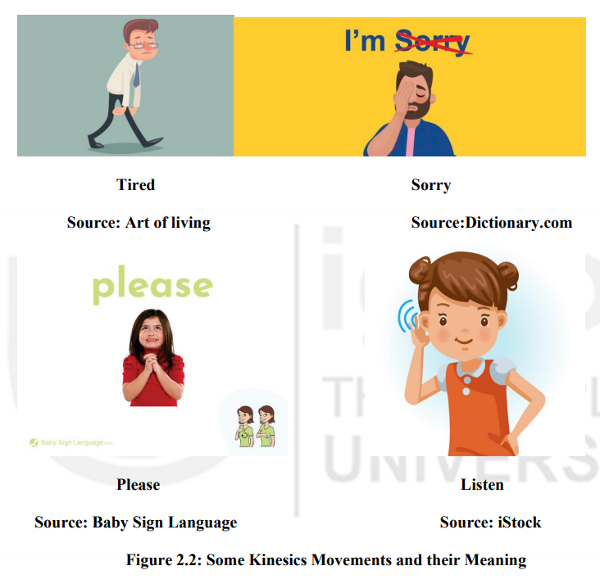

Slide 35
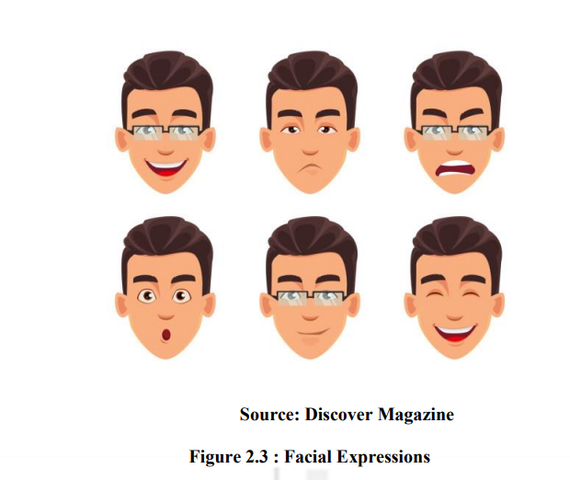
2. Facial Expressions
Face is the most expressive part of the body. The types of facial expressions distinctly reveal happiness, sadness, fear and anger
The expressions and their meaning are almost universal across cultures.
From the facial expressions of a speaker, it is possible to infer whether he is confident, excited, angry, shy, confused or tired.

Slide 36
3. Eye Contact (Oculesics)
Oculesics is the study of the role of eyes in nonverbal communication.
Oculesics is one form of nonverbal communication, which is the transmission and reception of meaning between communicators without the use of words.
It can include the environment around the communicators, the physical attributes or characteristics of the communicators, and also the behavior of the communicators
4. Proxemics
Proxemics refers to how people use and interpret space.
While taking to an unknown person, we keep a safe distance and if come closer, we feel uncomfortable. But while conversing with a friend, this space, shrinks.
Thus, there are different space depending on the relationship between the persons communicating.
In general, there are four types of space people use while communicating.
Public Space (12 Feet or more)
Social Space (4-12 Feet)
Personal Space (1.5 – 4 Feet)
Intimate Space

Slide 37
5. Appearance and Artifacts
Personal appearance is a major factor used to judge a person simply because the first impression of a person is based on appearance.
People can change their appearance by changing their clothing styles, hairstyles, and other accessories or artifacts.
Non verbal communication confers a meaning that is transmitted by physical characteristics of the body, attire, and accessories.
6. Paralanguage
Paralanguage refers to the non-verbal elements of communication used to modify meaning and convey emotion.
It may be expressed consciously or unconsciously.
It includes the pitch, volume, and, in some cases, intonation of speech.

Slide 38
7. CHRONEMICS:
It is the study of the use of time in nonverbal Communication. The way we perceive time, structure our time and react to time is a powerful communication tool, and also helps set the stage for the communication process.
Across cultures, time perception plays a large role in the nonverbal communication process. Time perceptions include punctuality, willingness to wait, and interactions.
The use of time can affect lifestyles, daily agendas, speed of speech, movements and also how long people are willing to listen.

